Slide 1
CSS
Cascading style sheet

Slide 2
Presentation Summary
What is CSS?
Style Sheet Implementation
Common CSS properties
The Box Model
HTML & DIVs
CSS Rule Structure

Slide 3
Introduction
What do you know about CSS?
What do you hope to do with CSS?
How familiar are you with HTML?

Slide 4
What is CSS?
The full form of CSS is “cascading style sheet”.
We are using CSS to apply design in our web pages.
CSS are case-insensitive.

Slide 5

with and without CSS

Slide 6
Types of CSS
We can apply CSS by 3 different process
Inline CSS
Internal CSS
External CSS

Slide 7
Background
It is used to apply the background for the entire web page or for one particular content.
We can apply image or color as a background.
background-color: gold; to apply color AS THE BACKGROUND
background : url(images/image_name.jpg); to apply image AS THE BACKGROUND.

Slide 8
BOX model
In CSS, the term "box model" is used when talking about design and layout.
The CSS box model is essentially a box that wraps around every HTML element. It consists of: margins, borders, padding, and the actual content.
We can create box model by using ,
border properties.
Outline properties.
We can have spacing using ,
Padding properties
Margin properties

Slide 9
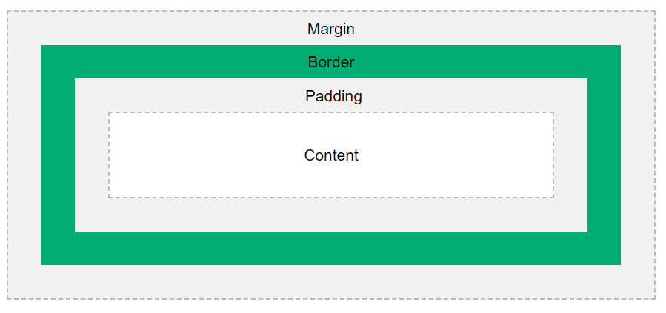
BOX model

Slide 10
CSS Selectors
Universal selector
Type selector
Class selector
ID selector

Slide 11
CSS Selectors
* {
font-family: cursive; // universal selector: applies the styles universally
}
h1 {
color: darkgreen; // type selector: applies the styles for that particular type of tags only.
}
#id1 {
color: darkgreen; // can be applied for any tags and any division using id attribute in that tags.
}
.cls1 {
color: rgb(35, 255, 35); // can be applied for any tags and any division using class attribute in that
tags.
}

Slide 12
CSS Combinators
A CSS selector can contain more than one simple selector. Between the simple selectors, we can include a combinator.
There are four different combinators in CSS:
descendant combinator (space)
child combinator (>)
adjacent sibling combinator (+)
general sibling combinator (~)

Slide 13
Properties and values
body {background: purple;}
h1 {color: green;}
h2 {font-size: large;}
p {color: #ff0000;}
Properties and values tell an HTML element how to display
body {
background: purple;
color: green;
}

Slide 14
Pseudo-classes
A pseudo-class is used to define a special state of an element.
For example, it can be used to:
Style an element when a user mouse over it
Style visited and unvisited links differently
Style an element when it gets focus

Slide 15
Pseudo-classes
Types :
: Active
: Focus
: Hover
: First child
: Last child

Slide 16
Pseudo-elements
A CSS pseudo-element is used to style specified parts of an element.
For example, it can be used to:
Style the first letter, or line, of an element
Insert content before, or after, the content of an element

Slide 17
Pseudo-elements
Types :
::selection Selects the portion of an element that is selected by a user
::after Insert content after every <tag> element
::before Insert content before every <tag> element
::first-letter Selects the first letter of every <tag> element
::first-line Selects the first line of every <tag> element

Slide 18
Display Properties
The display property specifies the display behavior of an element.
In HTML, the default display property value is taken from the HTML specifications or from the browser/user default style sheet.

Slide 19
Display Properties
Types of display values that we can apply
block Displays an element as a block element (like <p>).It starts on a new line
inline Displays an element as an inline element (like <span>).
inline-block can be used to give height and width
Flex display helps to display elements in a row (we can use align-items,
Justify-content).

Slide 20
CSS Transitions
CSS Transitions:
CSS transitions allows you to change property values smoothly, over a given duration.
Mouse over the element below to see a CSS transition effect:
In this chapter you will learn about the following properties:
transition
transition-delay
transition-duration
transition-property
transition-timing-function

